Slide 1
Day 10
Inverse Kinematics

Slide 2
Inverse Kinematics
given the pose of the end effector, find the joint variables that produce the end effector pose
for a 6-joint robot, given
find

Slide 3
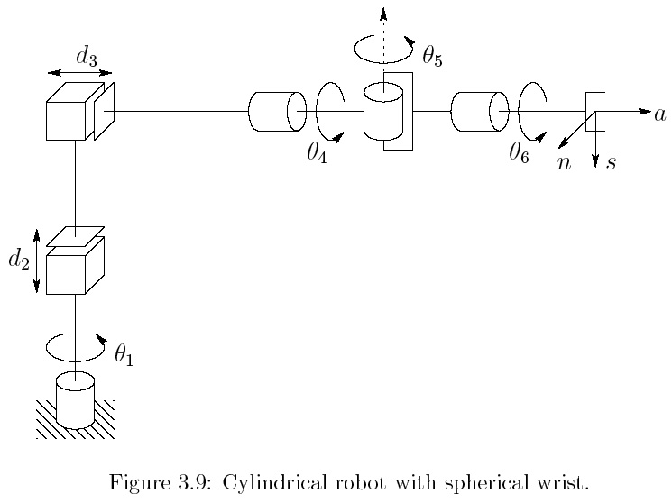
RPP + Spherical Wrist

Slide 4
RPP + Spherical Wrist
solving for the joint variables directly is hard

Slide 5
Kinematic Decoupling
for 6-joint robots where the last 3 joints intersecting at a point (e.g., last 3 joints are spherical wrist) there is a simpler way to solve the inverse kinematics problem
  use the intersection point (wrist center) to solve for the first 3 joint variables
    inverse position kinematics
  use the end-effector pose to solve for the last 3 joint variables
    inverse orientation kinematics

Slide 6
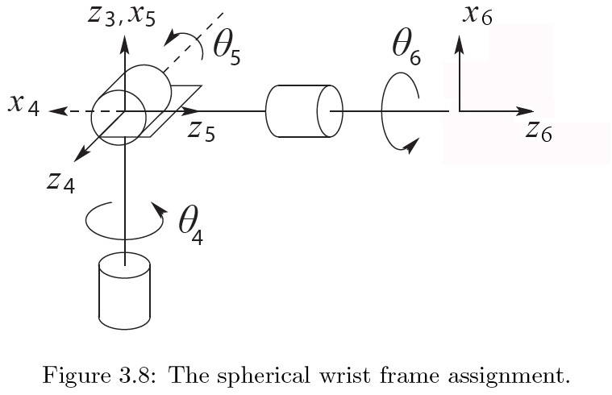
Spherical Wrist
o_{c}
o
d₆

Slide 7
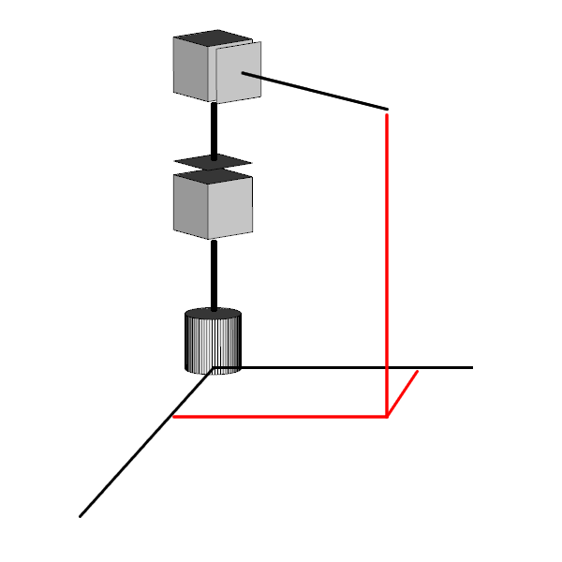
RPP Cylindrical Manipulator
d₃*
o_{c}
d₂*
d₁
y_{c}
x_{c}

Slide 8
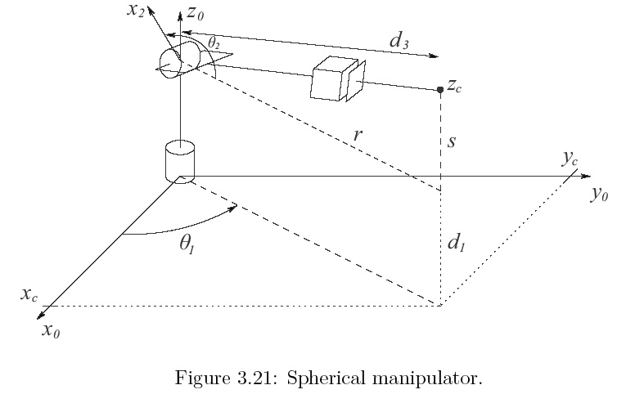
RRP Spherical Manipulator

Slide 9
Spherical Wrist
Link | a_{i} | α_{i} | d_{i} | θ_{i}
4 | 0 | -90 | 0 | θ₄*
5 | 0 | 90 | 0 | θ₅*
6 | 0 | 0 | d₆ | θ₆*
* joint variable

Slide 10
Spherical Wrist

